Slide 1

INTRODUCTION TO PYTHON PROGRAMMING FOR DATA ANALYTICS
Part I - Lecture 01
Introduction to Python
Lecturer: Maotong Sun
Technische Universität München
TUM Campus Heilbronn
Reference book:
Python Distilled (David Beazley)
Python Crash Course (Eric Matthes)

Slide 2

History of Python
Started in the late 1980s by Guido van Rossum.
Named after the BBC comedy series “Monty Python's Flying Circus.”
In 2018, Rossum stepped down as leader (although he remains the “Benevolent Dictator for Life”).
The five-member Steering Council now leads the project.
Guido van Rossum
https://gvanrossum.github.io/

Slide 3
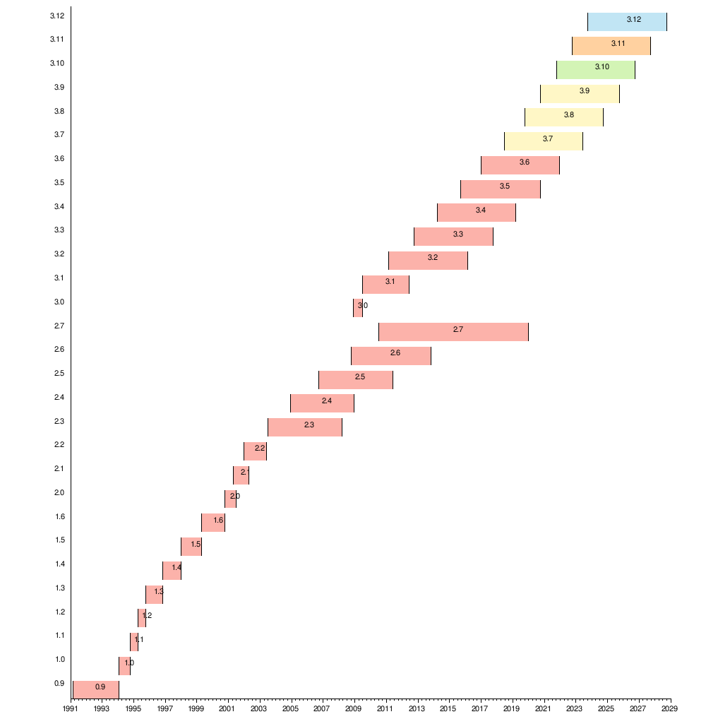
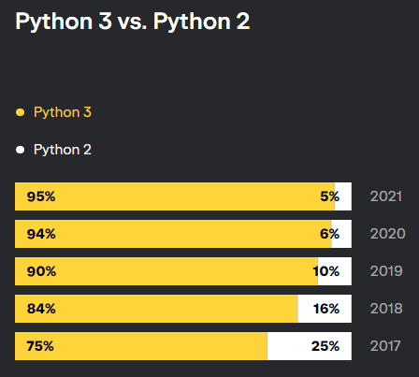
History of Python
https://lp.jetbrains.com/python-developers-survey-2021
https://en.wikipedia.org/wiki/History_of_Python

Slide 4
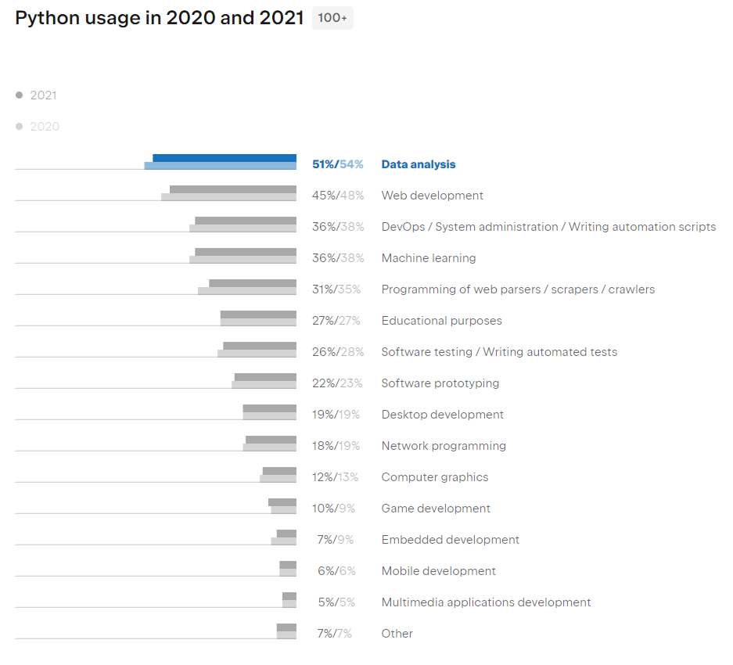
Application areas
https://lp.jetbrains.com/python-developers-survey-2021

Slide 5
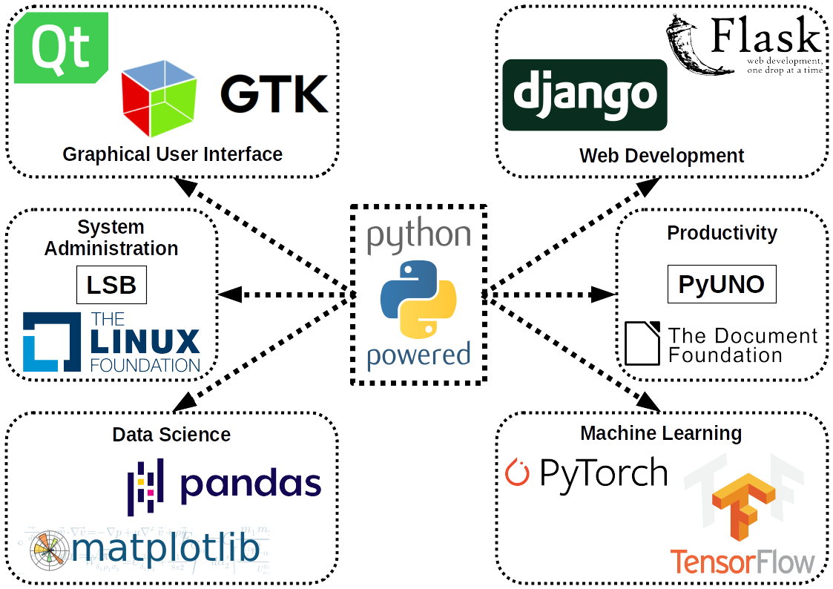
Frameworks
https://en.wikipedia.org/wiki/Python_(programming_language)#/

Slide 6

Apps built with Python
Source: https://appinventiv.com/blog/types-of-apps-developed-using-python/

Slide 7
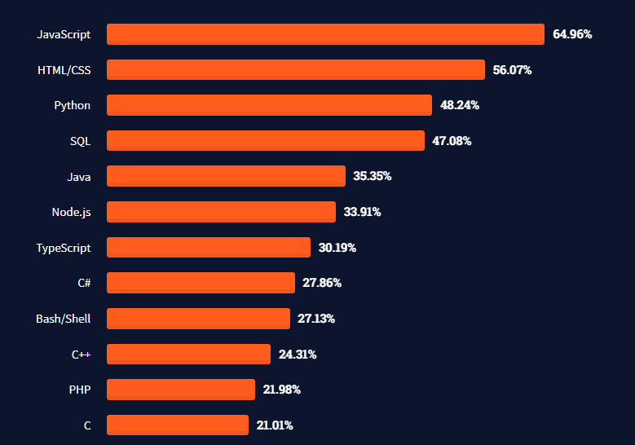
Popularity
Source: 2021 Stackoverflow Developer Survey

Slide 8
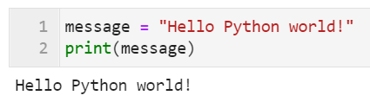
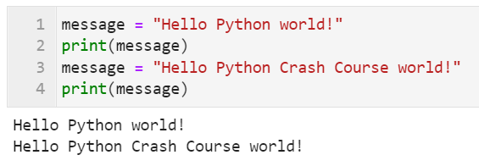
Variables
Definition
A variable is a name that refers to a value.
The value of a variable can be changed at any time in the program.

Slide 9
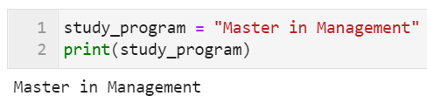
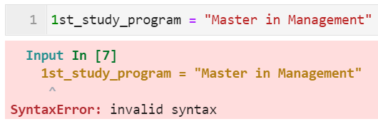
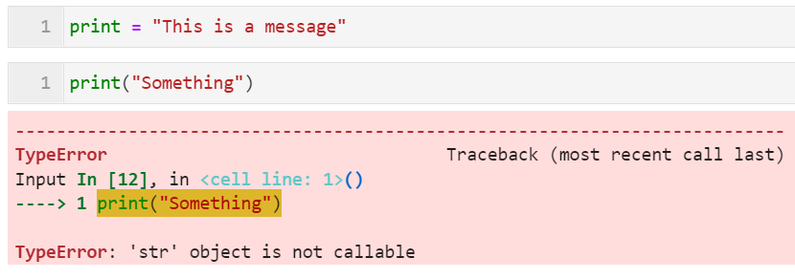
Variables
Rules and conventions
Rules:
Variable names can contain letters, numbers, and underscores. A variable name is not allowed to start with a number.
Avoid using Python reserved keywords. For instance: print, for, while, etc.

Slide 10
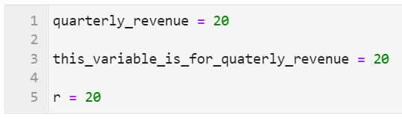



Variables
Rules and conventions
Conventions:
Variable names should be short but descriptive. Use small letters and separate words using underscores _.
Constants should be named using CAPITALIZED variable names.
It takes time and practice to be able to name variables properly. Expect your code to be read by other people!

Slide 11

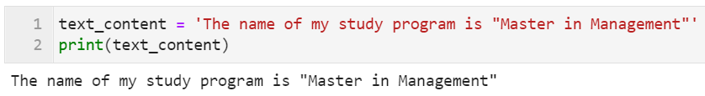
Simple data types
Strings
A string is a series of characters.
A string can be defined inside double quotes or single quotes.
Literal (double) single quotations can be used inside a (single)double-quoted string.

Slide 12
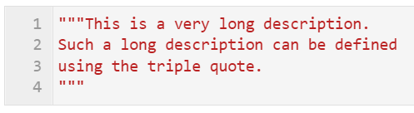
Simple data types
Strings
Multiple-lines string can be defined using the triple quote.
This is useful when the textual content span multiple lines (e.g., writing docstring, long comments, etc.).

Slide 13
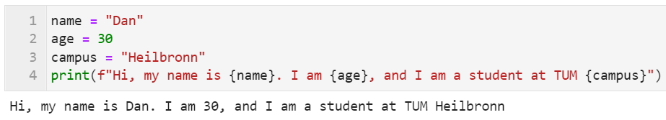
Simple data types
Modern string formatting
f-string was introduced in Python 3.6 and is currently the preferable way to format a string.

Slide 14


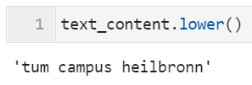

Simple data types
Manipulating strings
The case of a string can be changed using the following methods:

Slide 15
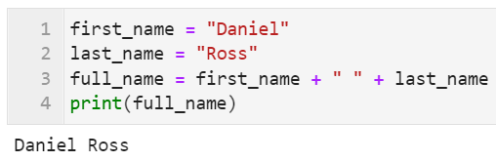
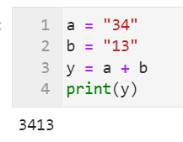
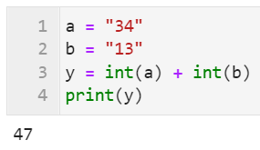
Simple data types
Manipulating strings
Python uses the + symbol to concatenate strings.
Note: Python will never implicitly interpret strings as numerical data.

Slide 16
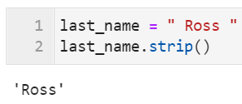
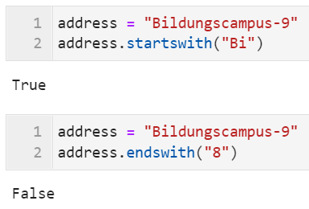
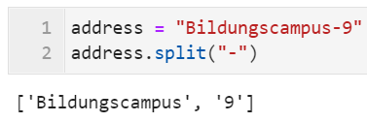
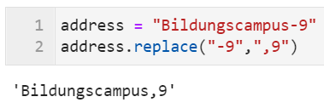
Simple data types
Manipulating strings – other useful methods
To strip leading and trailing white spaces, use the strip() method.
A string can be split using the split() method and specifying the delimiter.
We can check if a string starts or ends with a certain string using the startswith() and endswith() methods.
We can replace a substring within a string using the replace() method.

Slide 17

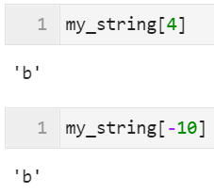
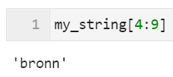
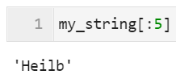

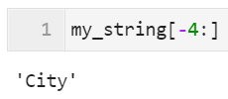
Simple data types
Manipulating strings – indexing and slicing
Forward indexing
0
1
2
3
4
5
6
7
8
9
10
11
12
13
H
e
i
l
b
r
o
n
n
C
i
t
y
-14
-13
-12
-11
-10
-9
-8
-7
-6
-5
-4
-3
-2
-1
Backward indexing

Slide 18
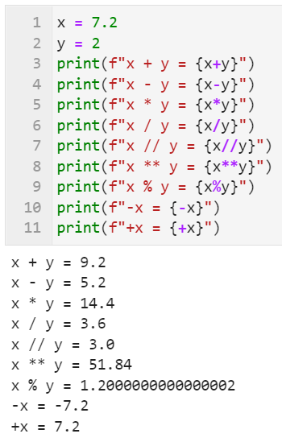

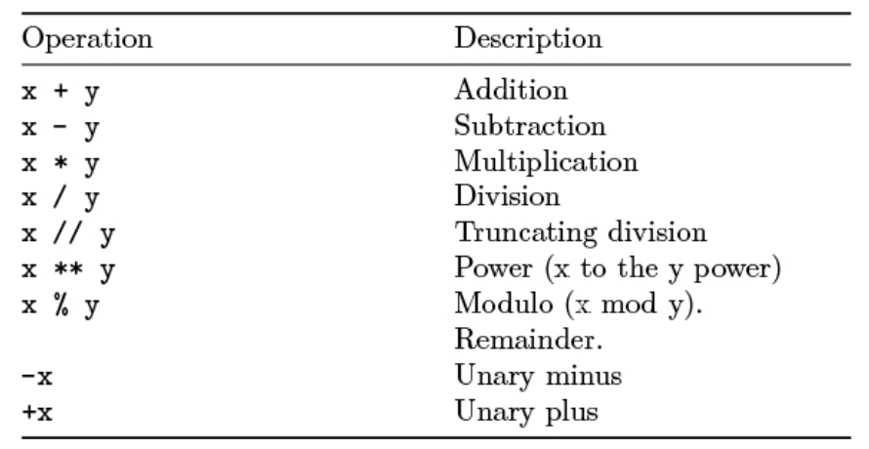
Simple data types
Integers & Floats - arithmetic operators

Slide 19
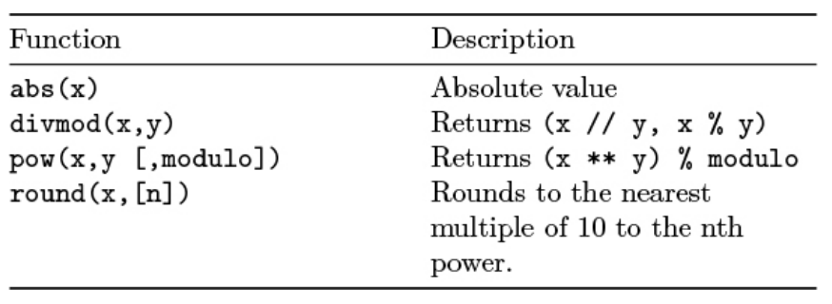
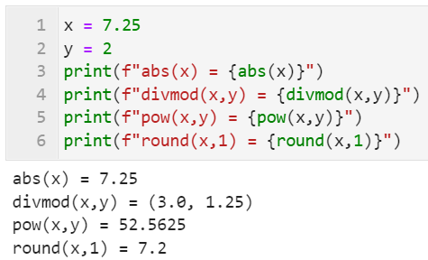
Simple data types
Integers & Floats – common mathematic functions

Slide 20

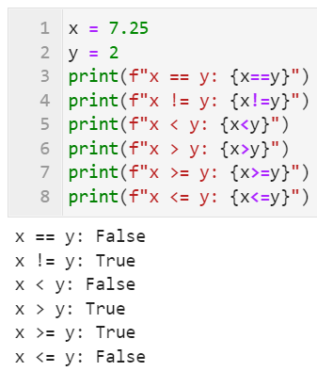
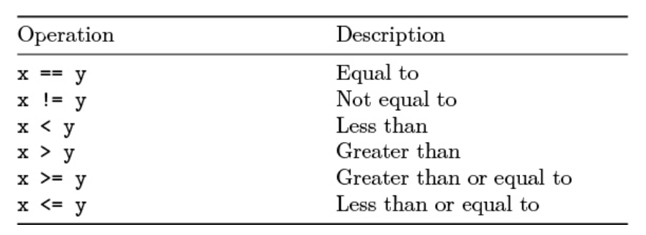
Simple data types
Booleans

Slide 21
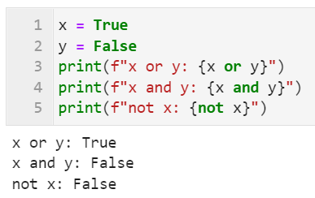

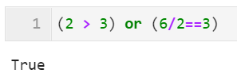
Simple data types
Logical operators
A | B | A and B | A or B | not A
False | False | False | False | True
False | True | False | True | True
True | False | False | True | False
True | True | True | True | False

Slide 22
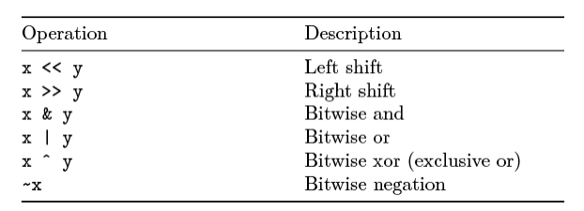
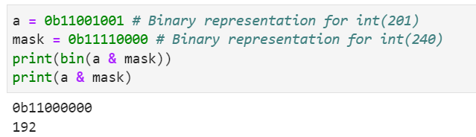
Bit manipulation
Cautions
Most common data science libraries use the & and | operators differently! (not as bit manipulation operators)

Slide 23
Question?

Slide 24
Quiz Time!
Which of the following operations results in 16?
4*4
4x4
2^4
17//16

Slide 25
Quiz Time!
Given the string mystring = “Technical University of Munich”, what is the results of mystring[-6:]
Techni
TUM
Munich
Univer

Slide 26
Quiz Time!
What is the printout of the following script?
a = 6
b = 10
print( a == 10 or b == 10 )
True
False
None
Cannot print

Slide 27
Quiz Time!
In Python, what is the proper way to name a variable that stores the value of the net profit calculation?
netProfit
NET_PROFIT
net_profit
net profit

Slide 28
Quiz Time!
Given the variable my_str = “data_manipulation.csv”
What is the printout of the following code:
print(my_str.split("_")[1].startswith("m"))
True
False
d
m

